Slide 1
Penobatan terkini stroke akut
Dr.L.Laksmiasanti SpS(K)
Bethesda Hospital
Neurology dep Fac of med UGM

Slide 3
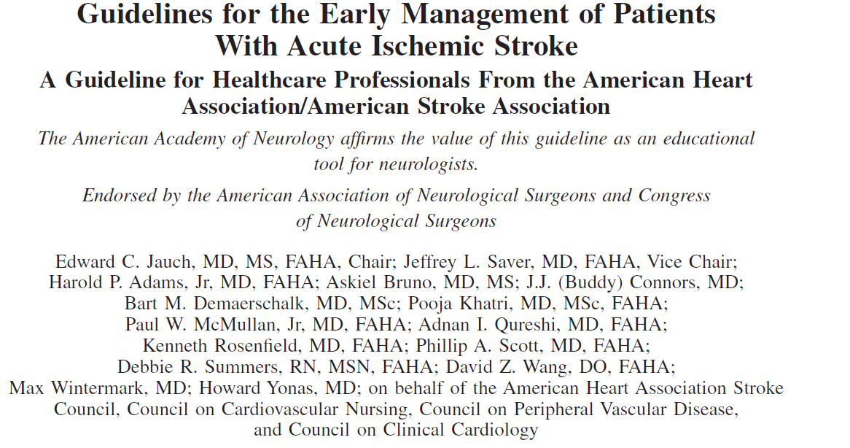

Slide 4
Tujuh tindakan berantai untuk survival dan penyembuhan stroke
Pre-arrival: Post-arrival:
Detection 4. Door
Dispatch 5. Data
Delivery 6. Decision
7. Drug
Notes:
Optimal care of the stroke victim of acute stroke must minimize delay in recognition of stroke symptoms, activation of the EMS system, rapid transport to and pre-arrival notification of a hospital capable of acute stroke care, appropriate evaluation and selection of eligible candidates (if applicable) for fibrinolytic therapy, and administration of fibrinolytics. Delays at any of these major points can increase the the negative outcome of the stroke patient – to include making them ineligible for fibrinolytic therapy.

Slide 5
1. Detection: Early Recognition
Pengobatan dini stroke tgt pada penderita, keluarga atau siapa saja yang mendapatkan dan mengetahui ada kejadian stroke.
Gejala sstroke yg ringan sering diabaikan baik si pasien maupun keluarga.
Notes:
1. Detection
Surveys completed within major metropolitan areas found that less than 20% of those asked could name numbness or weakness of one side of the body as a stroke warning sign. All other warning signs were even less known.
Public education is an essential part of any strategy to ensure timely access to care for stroke victims. It has been successful in reducing the time to arrival in the emergency department.

Slide 6
2. Dispatch: Early EMS Activation and Dispatch Instructions
Pasien Stroke dan klg harus segera memikirkan dan memanfaatkan segera EMS segera setelah menemukan tanda2 seseorang terkena stroke.
EMS harus memprioritaskan responsenya thd panggilan ini
Notes:
2. Dispatch
Stroke victims and their families must be taught to activate the EMS
system as soon as they detect stroke signs or symptoms. Currently only
half of stroke victims use the EMS system despite the fact that this
system provides the safest and most efficient method for transporting the
patient to the hospital.
Although highly skilled dispatchers can be effective in triaging
emergencies over the telephone, additional education about stroke is
required. In a recent study, just over half of the EMS dispatchers correctly
diagnosed stroke from the initial EMS call.
Contact with the EMS system not only enables the dispatch of trained
providers but also puts the victim or family members in contact with
someone who can provide emergency information. EMS dispatchers can
instruct bystanders in lifesaving skills, such as airway management,
positioning of the patient, and rescue breathing, while EMS personnel are
en route.

Slide 7
3. Delivery: Pre-hospital Transport and Management
Tujuan :
Mengidentifikasi stroke secepatnya
Support dari fungsi2 vital
Transport secepatnya ke fasilitas stroke
Pre-arrival notification ke fasilitas stroke
Notes:
3. Delivery
Rapid identification of the stroke
Support of vital functions
Rapid transport of the victim to the receiving facility
Pre-arrival notification of the receiving facility
EMS providers must be effectively trained in the recognition and treatment of stroke. EMS system protocols must assign a high priority to stroke patients. In most EMS systems, stroke patients are treated under a generic "altered mental status" protocol. Stroke must be suspected quickly by EMTs and paramedics in the field. In one study EMTs and paramedics correctly identified stroke and TIA in 72% of the patients with either condition.
Training must incorporate protocols that cover early recognition, early stabilization, early transportation, and early notification of the receiving facility.
Extensive medical histories and neurological exams by pre-hospital personnel are impractical, especially because gathering this data may delay transport to the ED.

Slide 8
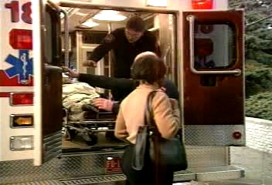

Slide 9
4. Door: Emergency Department Triage
walau pasien datang tepat waktu ke IGD, kadang2 banyak kendala untuk mendapatkan segera pemeriksaan dan penegakan diagnosyik stroke.
Notes:
4. Door
Hospitals should notify community EMS services whether they have the equipment and personnel to manage patients with acute stroke.
Some hospitals use "Code Stroke" or assemble a specific "stroke team" or prepare a designated "stroke unit" to organize personnel and equipment and evaluate and care for the stroke patient as efficiently as possible. This efficiency is maximized through the use of checklists, standing orders, and protocols.

Slide 10
5. Data: Emergency Evaluation and Management
emergency neurological stroke assessment segera dikerjakan dengan memperhatikan 4hal
Tingkat kesdarani
Tipe stroke (hemorrhagic versus nonhemorrhagic)
Lokasi stroke (carotid versus vertebrobasilar)
Berat ringan of stroke
Notes:
Level of Consciousness: Determining the stroke patient's level of consciousness is crucial. Depressed consciousness within hours of onset of stroke implies a severe brain insult with increased ICP, usually from an intracerebral or subarachnoid hemorrhage. Early stupor or coma is uncommon with nonhemorrhagic strokes although it may occur with massive hemispheric or brain stem infarction.
Type of Stroke: (Hemorrhagic versus nonhemorrhagic) Histories and physical findings of hemorrhagic and ischemic stroke overlap, and emergency personnel should not depend solely on the clinical presentation for diagnosis. In most cases, a noncontrast CT scan is the definitive test for differentiating ischemic from hemorrhagic stroke.
Location of Stroke: In alert patients with brain infarction, higher cortical, language, visual, cranial nerve, motor, and sensory functions should be assessed. The neurological signs help distinguish carotid infarction from infarction of the vertebrobasilar distribution.
Severity of Stroke: The National Institutes of Health Stroke Scale (NIHSS) measures neurological function that correlates with stroke severity and long-term outcome in patients with ischemic stroke. It was designed to provide a reliable, valid, and easy-to-perform alternative to the standard neurological examination for patients with ischemic stroke.

Slide 11
Emergency Diagnostic Studies
Saat ini CT scan merupakan alat dignostik yg penting.
Tujuan: CT dpt selesai dan dibaca dlm waktu 45 menit sejak pasien masuk ruang IGD.
Notes:
Diagnostic studies ordered in the emergency department are aimed at establishing stroke as the cause of the patient's symptoms, differentiating brain infarction from brain hemorrhage and determining the most likely cause of the stroke.

Slide 12
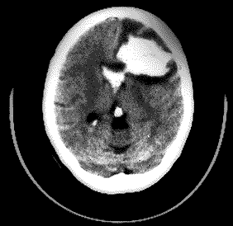
Emergency Diagnostic Studies
Anticoagulants dan fibrinolytic agents harus siap sp dipastikan CT menunjukkan tak ada perdarahan.
Hemorrhagic Stroke
Notes:
Noncontrast CT scan is the most important diagnostic test for an acute stroke.
On CT images blood from a hemorrhagic stroke has a density that is only about 3% greater than the density of brain tissue. On modern CT scanners this 3% difference in density can be manipulated so that the hemorrhage and free blood will appear distinctly white in comparison with surrounding tissue.
During the first few hours of a thrombotic or embolic stroke, the noncontrast CT scan will generally appear normal. Brain structures without normal blood flow appear initially the same as structures with good blood flow on the CT scan. For this reason the CT scan will continue to appear “normal” for a few hours after blood flow is blocked or reduced to an area of the brain. A well-defined area of hypodensity, purported to be caused by a lack of blood flow past an occlusion, will rarely develop within the first 3 hours of a stroke.

Slide 13
Differential Diagnosis:
Kejang yang blm jelas penyebabnya
Confusional states
Syncope
Toxic or metabolic disorders
Hypoglycemia
Brain tumors
Subdural hematoma
Adams et al. Stroke. 2003;34:1056
Notes:
Several conditions mimic stroke. Frequent alternative diagnoses include unrecognized seizures, confusional states, syncope, toxic or metabolic disorders, including hypoglycemia, brain tumors, and subdural hematoma. These mimics are commonly, but not always, associated with global findings rather than focal neurological symptoms and are usually readily detected with standard laboratory tests.

Slide 14
6. Decision: Specific Stroke Therapies
perawatan umum terutama :
Pencecahan dari aspirasi
Management of hypertension
Management of hyper/hypo-glycemia
Management of seizures
Management of intra-cranial pressure (ICP)
Acute Stroke, 2013 American Heart Association

Slide 15
7. Drugs: Fibrinolytic Therapy for Ischemic Stroke
pemilihan pasien secara cermat dan hati2 untuk pemebrian rTPA

Slide 16
7. Drugs: Fibrinolytic Therapy for Ischemic Stroke
karena kriteria waktu yg terbatas dan resiko pemberian fibrinolitic maka RS harus menciptakan suatu sop untuk dpt secepatnya memulai pengobatan dg rTPA.
Notes:
Three hours was chosen as the upper limit for treating acute stroke patients with IV tPA because that was the time window in the NINDS trial and the FDA used the NINDS protocol to define the upper limit of 3 hours. The NINDS investigators chose 3 hours because prior studies had raised concerns about the safety of giving tPA beyond 3 hours.
The fibrinolytic protocol should address the following issues:
Identification of patients with stroke in the prehospital setting
Assurance of prearrival hospital notification
Development and maintenance of rapid triage and medical evaluation in the emergency department
Development of a mechanism for rapidly obtaining a noncontrast head CT
Identification of who will read the CT
Determination of contraindications to fibrinolytic therapy
Location of fibrinolytic drugs and determination of how they will be mixed
Designation of who will administer drug
Consultation for atypical cases or hemorrhagic complications
Determination of where the patient will be admitted

Slide 17
NINDS-Recommended Stroke Evaluation Targets for Potential Fibrinolytic Candidates*
Time Target
Door to doctor | 10 minutes
Door to CT† completion | 25 minutes
Door to CT read | 45 minutes
Door to treatment | 60 minutes
Access to neurological expertise‡ | 15 minutes
Access to neurosurgical expertise‡ | 2 hours
Admit to monitored bed | 3 hours
*Target times will not be achieved in all cases, but they represent a reasonable goal. †CT indicates computed tomography. ‡By phone or in person.
Notes:
The National Institute of Neurological Disorders and Stroke (NINDS) study group has recommended timed goals for the evaluation of stroke patients who are candidates for fibrinolytic therapy. The purpose of these targets or goals is to suggest a timeline that provides a specific evaluation level for 80% of patients with acute stroke.

Slide 18
AIS ED STROKE CARE 24/7: 1-H EVALUATION, 1-H INFUSION
I. Triage–10 min
Review t-PA criteria
Page acute stroke team
Draw pre t-PA labs*
II. Medical Care–25 min
Place O2 , 2 NS IVs
Obtain BP, weight, NIHSS
Obtain 12-lead ECG
Send patient to CT
III. CT & Labs–45 min
Obtain lab results
Read CT
Return pt to ED
IV. Treatment–60 min
Start IV t-PA
Monitor for ICH sxs
HTN, headache
N/V, ↓ neuro status
*CBC, platelets, PT/INR, PTT, chem 7, cardiac panel

Slide 19
AIS EMERGENCY THERAPY: IV TISSUE PLASMINOGEN ACTIVATOR (T-PA)
Harus diberikan< 4.5 h—makin awal mkn baik hslnya
Stroke onset = wkt terakir terlihat normal
tak boleh jika glucose < 50
tak boleh jika BP > 185/110
perhatikan akibat tak diberi >>> kalau diberi
< 3.0 Hours
Tak ada batas umur
Tak ada batas luas stroke
Dpt diberikan pd pasien dg warfarin jika INR < 1.7
3.0-4.5 Hours
Tak boleh:
Pt > 80 th
NIHSS > 25
DM dan riw strokememakai warfarin

Slide 20
Intraarterial Thrombolysis
Intra-arterial thrombolysis dpt diberikan pd stroke center yg berpegalaman
Pada pasien yg emmenuhi kriteria hrs diberikan segera ( ASAP).
:
Primary intraarterial thombolysis
Defisit neurologi berat
Contraindications to iv thrombolysis (e.g. recent surgery), 3-6 h from symptom onset atau
Dense artery sign on the CT head scan
Rescue thrombolysis
Severe disabling neurological deficit and
Tak ada perbaikan dg IV thrombolysis
Tak ada rekanalisasi stlh iv thrombolysis
Brain stem stroke
Bisa sp 12 jam stlh onset
Occlusion of basilar artery documented on 4-vessel angiography
Bisa diberikan walau ada gangguan kesadaran dan pasien emmakai ventilator
Shaltoni et al 2007, Arnold et al 2002, 2003, Hill et al 2002

Slide 21
Multimodal Imaging
Justification | Class/Level of Evidence
Multimodal CT and MRI may provide additional information that will improve diagnosis of stroke | Class I; Level of Evidence A
Vascular imaging may help in selection of intravenous or intra-arterial therapies | Level of Evidence B
Vascular imaging should be performed if intra-arterial therapy is being considered beyond 3 hours from symptoms onset | Level of Evidence A
©2011 American Heart Association, Inc. All rights reserved.
Leifer et al. Published online in Stroke Jan. 13, 2011

Slide 22
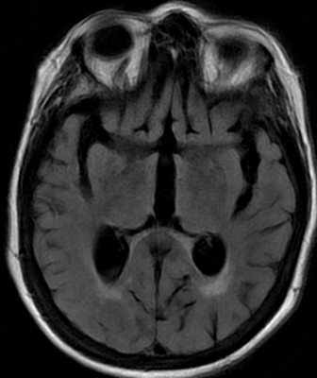
MRI BRAIN IN HYPERACUTE ISCHEMIC STROKE
DWI & ADC: memungkinkan melihat infart awal
FLAIR: blm terlihat perubahan signal;mungkin hanya perubahan sulci di area infarct
R
L
R
L
R
L
DWI
ADC
FLAIR

Slide 23
INTRACRANIAL MRA: AP VIEWS OF ANTERIOR CIRCULATION
Normal
Paucity of R MCA Branches
c/w Embolic Occlusions
RACA
LACA
RMCA
LMCA
RICA
LICA
RICA
LICA

Slide 24
Endovascular Treatment
Justification | Class/Level of Evidence
Endovascular thrombolysis dibawah 6 jam onset | Class I; Level of Evidence B
Mechanical thrombolysis with the Merci retriever or Penumbra aspiration catheter are options in patients with ischemic stroke | Class IIb;Level of Evidence B
©2011 American Heart Association, Inc. All rights reserved.
Leifer et al. Published online in Stroke Jan. 13, 2011

Slide 25
Symptomatic Intracranial Hemorrhage
Justification | Class/Level of Evidence
Symptomatik perdarahan intracranialmeningkat jika tak mengikuti protokol
Symptomatic perdarahan intracranial selalu menambhan buruk outcoma | Class I; Level of evidence A
©2011 American Heart Association, Inc. All rights reserved.
Leifer et al. Published online in Stroke Jan. 13, 2011

Slide 26
Carotid Revascularization
Justification | Class/Level of Evidence
Patient dg TIA or stroke dlm 6 bulan dg stenosis ipsilateral carotid stenosis diantara 70-99% hrs endarterectomi endarterectomy oleh surgeon dg morbidity dan mortality < 6% | Class I;Level of Evidence A
patients dg TIA atau stroke dan ipsilateral stenosi 50-69%, endarterectomy dianjurkan dgmorbidity and mortality < 6% | Class I; Level of evidence B
Patients with a stenosis of >70% in whom surgery technically difficult or restenosis after prior CEA or radiation injury to the neck carotid angioplasty and stenting is not inferior to CEA | Class IIb; Level of Evidence B
CEA may be useful in high grade asymptomatic patients with carotid stenosis if performed with a morbidity and mortality of < 3% | Class IIa; Level of Evidence A
CAS as an alternative to CEA in asymptomatic patients is uncertain in patients with high risk for CEA | Class IIb; Level of evidence C
©2011 American Heart Association, Inc. All rights reserved.
Leifer et al. Published online in Stroke Jan. 13, 2011

Slide 27
Stenting and angioplasty for intracranial atherosclerosis
Justification | Class/Level of Evidence
Angioplasty and stenting for intracranial atherosclerosis for secondary stroke prevention has been classified as investigational | Class IIb; Level of evidence C
For acute ischemic stroke, angioplasty and stenting have been classified as investigational | Class IIb; Level of evidence C
©2011 American Heart Association, Inc. All rights reserved.
Leifer et al. Published online in Stroke Jan. 13, 2011

Slide 28
Anticoagulant
Saat ini keguanan dr argatroban atau thrombin inhibitors lain utk terapi AIS blm well established (Class IIb; Level of Evidence B). These agents should be used in the setting of clinical trials. (New recommendation)
Juga kegunaan anticoagulation pd patient dg stenosis berat dr a, carotis interna ipsilateral dari daerah ischaemi belum well established (Class IIb; Level of Evidence B). (New recommendation)
Urgent anticoagulan, dg tujuan pencegah rekurent stroke, perburukan gejala stroke atau perbaikan outcome setelah AIS tdk di rekomendasi (Class III; Level of Evidence A). (Unchanged from the previous guideline¹³)
)

Slide 29
Urgent anticoagulation utk managemen kondisi non cerebral tdk direkomedasikan pd pasien stroke moderate –berat krn kemungkinan terjd perdrhan intracranial (Class III; Level of Evidence A). (Unchanged from the previous guideline¹³)
Pemberian anticoagulan dlm wkt 24 jam stlh rTPA tak dibenarkan ((Class III; Level of Evidence B). (Unchanged from the previous guideline¹³)

Slide 30
Antiplatelet
Pemberian Oral aspirin (initial dose is 325 mg) dlm wkt 24 sp 48 jam stlh onset dianjurkan (Class I; Level of Evidence A). (Unchanged from the previous guideline¹³)
The usefulness of clopidogrel for the treatment of acute ischemic stroke is not well established (Class IIb; Level of Evidence C). Further research testing the usefulness of the emergency administration of clopidogrel in the treatment of patients with acute stroke is required. (Revised from the previous guideline¹³

Slide 31
The efficacy of intravenous tirofiban and eptifibatide is not well established, and these agents should be used only in the setting of clinical trials (Class IIb; Level of Evidence C). (New recommendation)
Aspirin tdk direcommendasikan sbg tambahan pd acute interventions for treatment of stroke, including intravenous rtPA (Class III; Level of Evidence B). (Unchanged from the previous guideline¹³)

Slide 32
Pemberian IV antiplatelet penghambat glycoprotein IIb/IIIa receptor is not recommended (Class III; Level of Evidence B). (Revised from the previous guideline¹³) Msh perlu penelitian lanjutan.
Pemberian aspirin dm 24 jam pertama IV thrombolyisis tak dianjurkan (Class III; Level of Evidence C). (Revised from the previous guideline¹³)

Slide 33
SUPPORTIVE MEDICAL CARE: PREVENT COMPLICATIONS
Aspiration (Ngt sambil evaluasi menelan)
Deep-vein thrombosis
Sequential compression devices (if stroke < 48 h)
Heparin 5000 q8h or enoxaparin 40 mg/d
Urinary tract infection (avoid Foley catheters)
Constipation (docusate sodium for all)
Decubitus ulcers (move q2h, out of bed TID by day 2)
UI bleed (H2B, but not cimetidine)
Fever (acetaminophen + antibiotics as indicated)

Slide 34
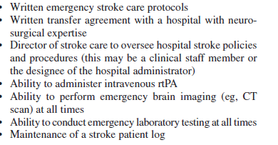
Primary stroke care

Slide 35
THE END

