Slide 1
Pencegahan stroke ulang/secundair
Dr L.Laksmiasanti Sp S(K)
Bg peny syaraf RS Bethesda

Slide 2
Pencegahan stroke meliputi
Tindakan promotif
Sasaran : individu sehat
Tujuan mencegah timbulnya faktor resiko
Cara : gaya hidup sehat
Prevensi primer
Sasaran : individu yg mempunyai faktor resiko
Tujuan :mencegah stroke
Cara :gaya hidup sehat dan mengendalikan faktor resiko
Prevensi sekunder

Slide 3
Prevensi sekunder
Sasaran : individu yg pernah mengalami stroke
Tujuan : mencegah terjadinya stroke ulang
Cara :
gaya hidup sehat
Mengendalikan faktor resiko
Terapi medikamentosa anti platelet atau anticoagulan
Terapi bedah trombektomi/angiopasti/stenting

Slide 4
Gaya hidup sehat
Mengatur pola makan
Menghentikan merokok
Menghindari alkohol dan penyalah gunaan obat
Melakukan OR teratur
Menghindari stress dan istirahar cukup

Slide 5
Mengatur pola makan
Makanan yg membantu menurunkan kolesterol
Serat larut yg ada dlm biji2an, mis beras merah jagung
Oat/hevermout
Kacang kedele
Kacang2 an

Slide 6
Makanan yg berpengaruh thd pencegahan stroke
Mkn yg membentu mencegah homocystein mis as folat, b6,b12 riboflavin
Susu dan ca
Ikan yg mengandung omega 3
Mkn kaya vit C ,E dan beta karoten
Teh hitam/hijau
Buah2an dan sayuran

Slide 7
Menghentikan merokok
Rokok meningkatkan koagubilitas, viskositas drh, menaikkan kdr fibrinogen, meningkatkan aggregasi, menurunkan HDL

Slide 8
Menghindari alkohol dan penyalah gunaan obat
Meningkatkan aggregasi

Slide 9
Melakukan OR yg teratur
Aktivitas fisik yg mempunyai nilai aerobik mis jln cepat , sepeda, renang, akan menurunkan tek drh, menurunkan kdr gula, menurunkan BB
Menurunkan aktivitas platelet, dan fibrinogen, menaikkan aktivitas tissue plaminogen aktivator dan HDL.

Slide 10
Menghindari stress dan istirahat cukup
Istirahat teratur 6-8 jam sehari
Menghindari stress dg berpikir positip

Slide 11
Mengendalikan faktor resiko stroke
Penggolongan faktor resiko
Faktor resiko yg tak dpt diubah atau dimodifikasi
Faktor resiko yang dpt dimodifikasi
Faktor resiko yang sangat dapat diubah-dimodifikasi

Slide 12
Pentingnya mengetahui faktor resiko
70 % stroke adalah stroke yang pertama
Di Inggris/negara maju insiden turun 40% setelah diupayakan pengobatan/pencegahan faktor resiko

Slide 13
Faktor resiko yang dapat diubah
Tekanan darah tinggi
Merokok
Diabetes mellitus
Penyakit jantung/atrial fibrillation
Kenaikan kadar cholesterol/lemak darah
Penyempitan pemb darah carotis
Penggunaan terapi sulih hormon

Slide 14
Kegemukan

Slide 15
Faktor resiko yang sangat dapat diubah
Metabolik sindrom
Pemakaian alkohol berlebihan
Drug abuse/narkoba
Pemakainan obat2 OC
Gangguan pola tidur

Slide 16
Kenaikan homocystein
Kenaikan lipoprotein
Hypercoagubility
Peradangan pembuluh darah
dll

Slide 17
Faktor resiko yang tak dapat diubah

Slide 18
Faktor resiko yang tak dapat diubah
Umur
Jenis
Berat lahir rendah
Ras
Faktor keturunan
Kelainan bawaan

Slide 19
Faktor resiko yang dapat diubah

Slide 20
Hypertensi/tekanan darah tinggi
Makin tinggi tekanan darah makin tinggi terjadinya stroke baik penyumbatan maupun perdarahan

Slide 21
Hipertensi sebagai salah satu penyebab stroke sekunder
Sekitar 72 juta penduduk USA menderita tek drh tinggi (≥ 140/90 ).
Meta-analysis of randomized controlled trials meneliti 30-40 % pasien yg diturnkan tek drhnya.
Risk reduction lbh besar pd penurunan yg lbh tinggi.
Dari data yg ada maka pemakaian ACE dan diuretik penting.
©2010 American Heart Association, Inc. All rights reserved.

Slide 22
Recommendations for Treatable Vascular Risk Factors
Risk Factors Recommendation – Hypertension | Class/Level of Evidence
BP reduction is recommended for both prevention of recurrent stroke and prevention of other vascular events in persons who have had an ischemic stroke or TIA and are beyond the first 24 hours | Class I; LOE A
Because this benefit extends to persons with and without a documented history of hypertension, this recommendation is reasonable for all patients with ischemic stroke or TIA who are considered appropriate for BP reduction | Class IIa; LOE B
An absolute target BP level and reduction are uncertain and should be individualized, but benefit has been associated with an average reduction of approximately 10/5 mm Hg, and normal BP levels have been defined as <120/80 mm Hg by JNC 7 | Class IIa; LOE B
©2010 American Heart Association, Inc. All rights reserved.

Slide 23
Pemilihan jenis obat juga disesuaikan dg kondisi msg2 individu dan tgt juga peny penyerta mis gangguan ginjal, peny jantung dsbnya

Slide 24
Diabetes mellitus
Membuat kecenderungan artheriosclerosis
Meningkatkan hypertensi,kegemukan dan kenaikan lemak drh
Perlu pengobatan jika gula puasa >126 mg % , sewaktu>200 mg %, Hba1C >6,5
Diusahakan gula puasa <126 mg
HbA1C<6,5 %

Slide 25
PENYAKIT JANTUNG/ATRIAL FIBRILLATION
Apapun penyebab AF beresiko adanya emboli → thrombus di pembuluh drh otak.

Slide 26
Recommendations for Patients With Cardioembolic Stroke Types
Risk Factor – Atrial Fibrillation | Class/Level of Evidence
For patients with ischemic stroke or TIA with paroxysmal (intermittent) or permanent AF, anticoagulation with a vitamin K antagonist (target INR 2.5; range, 2.0 to 3.0) is recommended. | Class I; LOE A
For patients unable to take oral anticoagulants, aspirin alone is recommended. The combination of clopidogrel plus aspirin carries a risk of bleeding similar to that of warfarin and therefore is not recommended for patients with a hemorrhagic contraindication to warfarin. | Class I; LOE A Class III; LOE B New Recommendation
For patients with AF at high risk for stroke (stroke or TIA within 3 months, CHADS₂ score of 5 or 6, mechanical valve or rheumatic valve disease) who require temporary interruption of oral anticoagulation, bridging therapy with an LMWH administered subcutaneously is reasonable. | Class IIa; LOE C New Recommendation
©2010 American Heart Association, Inc. All rights reserved.

Slide 27
CHA2DS2VASc score and stroke rate
Risk factors for stroke and thrombo-embolism in non-valvular AF
Major risk factors | Clinically relevant non major risk factors
Previous stroke, TIA or systemic embolism, age > 75 yrs | Heart failure or moderate to severe LV systolic dysfunction (e.g. LV EF < 40%) Hypertension, DM, Female sex, Age 65–74 yrs,Vascular disease
Risk factor-based approach expressed as a point based scoring system, with the acronym CHA2DS2-VASc (maximum score is 9)
CCF/LVV dysfunction (<40%) | 1
Hypertension | 1
Age >/=75 (MAJOR) | 2
DM | 1
Stroke/TIA/thromboembolism (MAJOR) | 2
Vascular disease | 1
Age 65-74 | 1
Female sex | 1

Slide 28
Recommendations
CHA2DS2-VASc score | Rx
2 or more | OAC
1 | OAC or aspirin but prefer OAC
0 | Either aspirin or no Rx prefer no treatment

Slide 29
 | Clinical Characteristics | Score
H | Hypertension >160 | 1
A | Abnormal liver (cirrhosis or biochemical evidence hepatic dysfunction) and renal function (creatinine >200 or transplantation/dialysis) | 1 or 2
S | Stroke | 1
B | Bleeding (previous bleeding history/predisposition to bleeding) | 1
L | Labile INR (< 60% time in therapeutic range 2-3) | 1
E | Elderly (> 65 years) | 1
D | Drugs (concominant use of NSAIDA/aspirin) or alcohol abuse (1 point for each) | 1 or 2
 | A score >/=3 equals high risk | Max 9

Slide 30
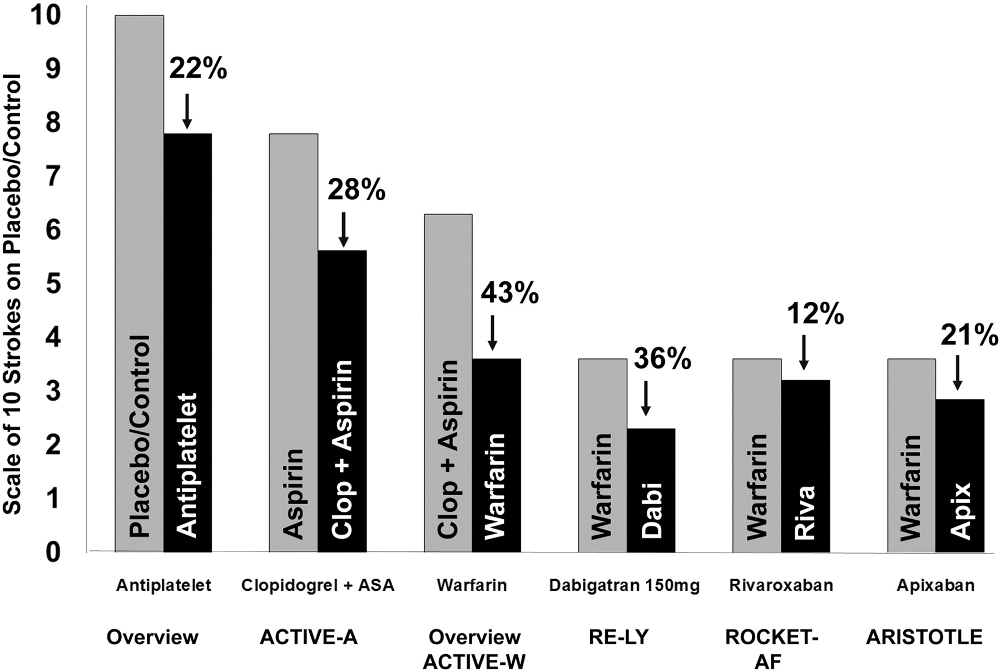
Stroke risk reductions from randomized trials of antithrombotic agents in atrial fibrillation.
Granger C B , Armaganijan L V Circulation 2012;125:159-164
Copyright © American Heart Association
Notes:
30
Stroke risk reductions from randomized trials of antithrombotic agents in atrial fibrillation. Relative risk reduction on a scale with 10 strokes for no antithrombotic therapy (placebo) is shown. The 22% relative risk reduction of antiplatelet therapy vs placebo and the 64% relative risk reduction of warfarin vs placebo are from Hart et al (Ann Intern Med. 2007;146:857–867). The 28% relative risk reduction of clopidogrel vs aspirin is from Atrial Fibrillation Clopidogrel Trial With Irbesartan for Prevention of Vascular Events (ACTIVE-A) (N Engl J Med. 2009;360:2066–2078), the 43% relative risk reduction of warfarin vs clopidogrel (Clop) plus aspirin is from the Atrial Fibrillation Clopidogrel Trial With Irbesartan for Prevention of Vascular Events (ACTIVE-W) (Lancet. 2006;367:1903–1912), and the warfarin rate is reset to the 64% relative risk reduction compared with control from the overview (Ann Intern Med. 2007;146:857–867). The 36% relative risk reduction of dabigatran 150 mg (Dabi) vs warfarin is from Randomized Evaluation of Long-Term Anticoagulant Therapy (RE-LY) (N Engl J Med. 2009;361:1139–1151), the 12% relative risk reduction of rivaroxaban (Riva) vs warfarin is from the Rivaroxaban Once Daily Oral Direct Factor Xa Inhibition Compared With Vitamin K Antagonism for Prevention of Stroke and Embolism Trial in Atrial Fibrillation (ROCKET-AF) (for stroke or systemic embolism) (N Engl J Med. 2011;365:883–891), and the 21% relative risk reduction of apixaban (Apix) vs warfarin is from Apixaban for Reduction in Stroke and Other Thromboembolic Events in Atrial Fibrillation (ARISTOTLE) (N Engl J Med. 2011;365:981–992).

Slide 31
Kenaikan kadar lemak drh/cholesterol dsbnya
Penelitian menunjukkan angka stroke meningkat pd kadar cholesterol > 240 mg%
Setiap kenaikan 38,7 mg % (1 mmol) menaikkan stroke 25 %
Kenaikan HDL 1 mmol menurunkan stroke 47 %
Setiap penurunan 1 mmol ldl chol menurunkan 9 % kematian krn vasculair
Perlu pemberian obat2 gol statin

Slide 32
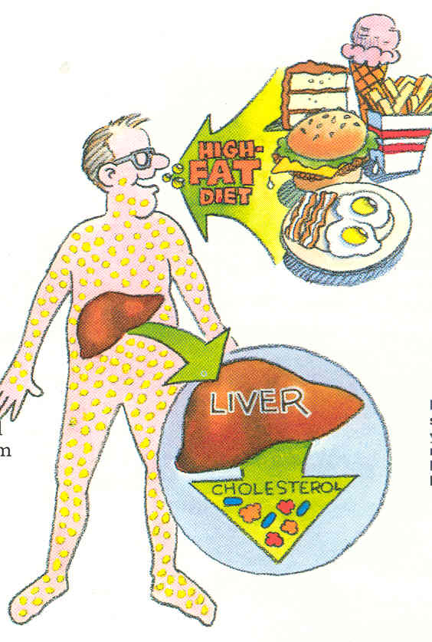
Darimanakah kolesterol berasal?
DALAM tubuh 80% (endogen)
Di produksi oleh tubuh sendiri (hati)
LUAR tubuh 20% (exogen)
Makanan yang di makan (Daging, telur, mentega dll)

Slide 33
Jenis-jenis kolesterol
LDL (Low Density Lipoprotein)
Kolesterol JAHAT
Mempercepat proses aterosklerosis pada dinding pembuluh darah (pembentukan plaque)
HDL (High Density Lipoprotein)
Kolesterol BAIK
Memindahkan LDL dari dinding pembuluh darah

Slide 34
Faktor-faktor risiko yang mempercepat terjadinya aterosklerosis
Kadar LDL-C (kolesterol jahat) yang tinggi ADALAH FAKTOR RISIKO UTAMA
FAKTOR RISIKO Lain yang perlu Diwaspadai:
Merokok
Kegemukan (obesitas)
Kebiasaan mengkonsumsi alkohol
Kurangnya olah raga
Hipertensi (Tekanan darah tinggi)
(TD: > 140/90 mmHg atau sedang dalam pengobatan TD)
Kadar HDL-C (kolesterol baik) yang rendah ( < 40mg/dL)
Riwayat Keluarga:
Ada keluarga langsung yang terkena serangan jantung di usia:
Laki-laki (ayah, kakak, adik) sebelum usia 55 tahun
Wanita (Ibu, kakak, adik) sebelum usia 65 tahun
Usia:
Laki-laki > 45 tahun
Wanita > 55 tahun
Catatan: HDL > 60mg/dL merupakan pengurang 1 faktor risiko
Grundy, Implication of Recent Clinical Trials for The NCEP/ATP III Guidelines. Circulation.2004;110:227-239

Slide 35
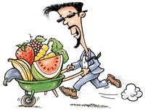
Apa yang harus dilakukan?
Diet
Mengurangi makanan berlemak atau yang mengandung kolesterol tinggi
Perbanyak makanan dengan serat tinggi
Kurangi berat badan mencapai berat ideal
Perbanyak konsumsi buah dan sayuran
Olah Raga secara teratur
Kepatuhan Terapi
Cek kadar kolesterol secara berkala
Periksa ke Dokter secara teratur
Minum obat sesuai anjuran Dokter secara teratur dan benar (sesuai dosis dan jangka waktu yang ditentukan Dokter)

Slide 36
Berapakah target LDL-C yang harus dicapai?
FAKTOR RISIKO LDL GOAL
0-1 Faktor risiko <160 mg/dL
2 Faktor risiko atau lebih <130 mg/dL
Risiko tinggi
PJK atau yg setara dgn PJK (DM) <100 mg/dL
Risiko sangat tinggi (PJK + DM) < 70 mg/dL
Diabetes Mellitus (DM) ≈ PJK
NCEP Expert Panel. JAMA. 2001;285:2486-2497.
NCEP Expert Panel. JAMA. 2001;285:2486-2497.

Slide 39
Who to Treat: New US Guidelines
Group 1
Clinical ASCVD
CHD, stroke, and peripheral arterial disease, all of presumed atherosclerotic origin
Group 2
LDL-C ≥190 mg/dL (~5 mmol/L)
Group 3
Diabetes mellitus
+ age of 40–75 years + LDL-C 70–189 mg/dL (~1.8–5 mmol/L)
Group 4
ASCVD risk ≥7.5%
No diabetes + age of 40–75 years + LDL-C 70–189 mg/dL
(~1.8–5 mmol/L)
Stone NJ, et al. J Am Coll Cardiol 2013 Nov 7. Epub ahead of print
Notes:
Note. 1 mmol/L = 38.7 mg/dL This deck uses a conversion of approximately 40 to provide convenient numbers

Slide 40
Intensity of Statin Therapy
High | Moderate | Low
⬇ LDL-C ≥50% | ⬇ LDL-C 30 to <50% | ⬇ LDL-C <30%
Atorva 40-80 mg Rosuva 20-40 mg | Atorva 10 mg Rosuva 10 mg Simva 20-40 mg Pravas 40 mg Lova 40 mg Fluva XL 80 mg Fluva 40 mg bid Pitava 2-4 mg | Simva 10 mg Prava 10-20 mg Lova 20 mg Fluva 20-40 mg Pitava 1 mg
Statins in bold were evaluated in randomized controlled trials;
those in italics were not
2013 ACC/AHA Guideline on the Treatment of Blood Cholesterol to Reduce Atherosclerotic Cardiovascular Risk in Adults, p 34

Slide 41
Intensity of Treatment
Known ASCVD: high-intensity statin*
LDL-C >190 mg/dl: high-intensity statin*
Diabetes, age 40-75, LDL-C 70-189 mg/dl: moderate-intensity statin unless score ≥7.5%, then high-intensity statin
Patients aged 40-75, LDL-C 70-189 mg/dl with a global 10-year risk score of ≥7.5%: moderate to high-intensity statin
* Unless >75 years old or statin-intolerant, then use moderate-intensity statin
2013 ACC/AHA Guideline on the Treatment of Blood Cholesterol to Reduce Atherosclerotic Cardiovascular Risk in Adults

Slide 42
Penyempitan pemb drh carotis
Sering tanpa gejala dan diketahui hanya dg pemeriksaan
Pd umur >65 thn 7 % laki2 menyempit >50% dan perempuan 5 %
Perlu pemberian obat sejenis aspirin, atau carotid endarterectomy/stenting
Bisa diketahui dengan TCD

Slide 43
Kegemukan
BMI/body mass index : BB(kg) : TB(m)‏²
>25-29,9 overweight
>30 obesitas
Disebut central obesitas jika lingkar perut >102 cm pd laki2 dan >88 cm pada perempuan
Utk Asia laki2 >90 cm,perempuan>80 cm
Penurunan BB menurunkan resiko stroke dan menurunkan tensi

Slide 44
Faktor resiko yang sangat dpt diubah

Slide 45
Metabolik sindrom
Dikatakan met sindrom jika ada 3 gejala atau lebih : 1.gemuk perut
2.trigliceride >150 mg %
3.HDL < 40 mg %
4.Tensi ≥ 130≥85 mm Hg
5.gula puasa ≥ 110 mg %
Perubahan gaya hidup,pola makan dan penurunan BB dan diet seimbang menurunkan terjadinya stroke

Slide 46
Gangguan pola tidur
Tidur ngorok memicu stroke, krn terjadi apneu/henti napas
Perlu pemeriksaan di sleep lab
Perlu dicari penyebabnya

Slide 47
Homocystein
Merupakan asam amino yg mengandung sulphur dan dpt dikonversikan menjadi metionin dan cystein.Kekurangan vit B 12 dan asam folat menggangu metabolisme dan menaikkan kadar homocystein
Diet kaya sayur dan buah menurunkan kadar homocystein

Slide 48
Lipoprotein (A)‏
merupakan partikel dr Ldl cholesterol, menghambat plasminogen aktivator, menyebabkan thrombose
Dapat diberikan niacin

Slide 49
Tindakan medis utk prevensi stroke sekunder
Obat2 anti thrombotik
Aspirin
Clopidogrel
Ticlopidin
Cilostazol

Slide 50
Notes:
MATCH, CHARISMA, ESPIRIT, PROFESS

Slide 51
Symptomatic Extracranial Carotid Disease
Several randomized and nonrandomized trials have compared surgical intervention (carotid endarterectomy- CEA) with best medical therapy alone.
Best medical therapy did not include use of HMG-CoA reductase inhibitors (statins), alternative antiplatelets (such as clopidogrel or sustained-release dipyridamole-aspirin), optimization of BP control, and smoking cessation therapy.
Surgical techniques have evolved.
Carotid angioplasty and stenting (CAS) have emerged as alternative treatments for stroke prevention in persons deemed at high risk for conventional endarterectomy.
©2010 American Heart Association, Inc. All rights reserved.

Slide 52
SECONDARY STROKE PREVENTION: CAROTID STENOSIS PROCEDURES
Carotid Endarterectomy (CEA)
Clear benefit if 70-99% stenosis
Some benefit if 50-69% stenosis
Accept complication rate < 6%
Carotid Angioplasty/Stenting (CAS)
Now, option only in high-risk pts
Restenosis after CEA
Radiation-induced stenosis
Increased medical risk for CEA
Contralateral carotid occlusion
Cerebral protection devices improving, trials continue
Internal
Carotid
Artery
D
External
Carotid
Artery
N
stenosis
in ICA bulb
% stenosis
= (D-N)/D
by contrast
angiography
Common
Carotid
Artery

Slide 53
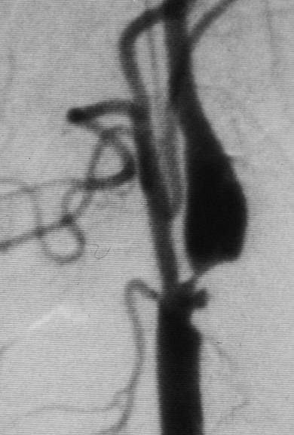
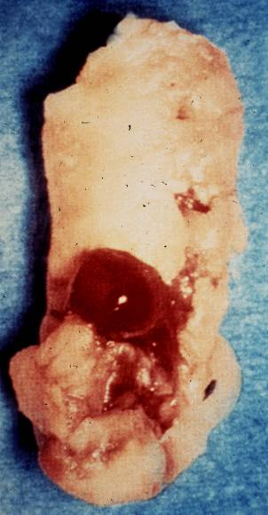
Carotid Endarterectomy: Conventional Gold Standard Surgical Treatment
Left image: High grade internal carotid artery stenosis, digital subtraction image, suggestive of ulceration.
Right image: pathologic specimen of carotid artery plaque with thrombus.
©2010 American Heart Association, Inc. All rights reserved.

Slide 54
Terima kasih

Slide 55
stroke and dislipidaemia\dyslipidaemia and cerebrovasculair disease 30 November 2013.ppt

